Slide 1
SM-Agrikultura
Numeru Ekstensionista iha Munisipiu Baucau
Total Ekstensionista | 34
Total Suku | 62
Ekstensionista ne’ebe falta | 37
Irrigasaun iha Munisipiu Baucau
Irrigasaun Boot | 4 | 3347 ha
Irrigasaun Semi Tekniku | 1 | 766 ha
Irrigasaun Kiik | 9 | 700 ha
Asosiasaun Produs Fini Komersial
Assossiasaun | Ai-horis | Tonelada
11 | Batar Sele | 11 ton e 800 kg
 | Batar Noi Mutin | 5
 | Hare Nakroma | 69
 | Utamua Sertifikadu | 1

Slide 2
Podusaun Batar no hare Munisipiu Baucau
Kualidade | Tonelada
Batar | 10,734
Hare | 24405.84
Fila Rai Gratuita iha Munisipiu Baucau
Postu Administrativu | Familia ka Uma kain | Hectare
3 | 208 | 167
Fila Rai Bokon/Natar iha Munisipiu Baucau
Postu Administrativu | Familia Uma kain | Hectare
3 | 354 | 299
Ekipmentu no Fasilidade Operasional iha Baucau
Kualidade | Kuantidade
Kareta | 3
Trator Bo’ot | 33
Fasilidade Pekuaria | 2
Floresta Plantas Industriais e Kafe | 0

Slide 3
Distribuisaun Fini Batar no Hare Iha Munisipiu Baucau
Batar | Postu Administrativu | Kilograma | Hare | Postu Administrativu | Kilograma
 | 6 | 8000 |  | 6 | 10000
DADUS POPULASAUN ANIMAL MUNICIPIO BAUCAU TINAN 2025
Postu Administrativu | Karau Timor | Karau Vaka | Kuda | Fahi | Bibi Timor | Bibi Malae | Manu Lokal | Manu Rade
8 | 11432 | 2524 | 3842 | 10780 | 6668 | 1782 | 16032 | 74
Dadus Matadouru Munisipiu Baucau tinan 2025 ne’ebe oho iha Merkadu Munisipal Baucau
Karau Timor | Karau Vaka | Fahi
150 | 145 | 107
Dadus Tranzitu Animal ne’ebe Husi Baucau ba Municipio Seluk tinan 2025
Karau Timor | Karau Vaka | Kuda | Fahi | Bibi Malae | Bibi Timor
79 | 69 | 77 | 39 | 48 | 46
Total Animal ne’ebe hetan Vasinasaun iha tinan 2025
Postu Administrativu | Manu | Karau Timor | Karau Vaka
6 | 29346 | 1662 | 85

Slide 4
SM-Agrikultura
NUMERU EXTENSIONISTA NEBE PRESIZA TUIR TOTAL SUKU
NU. | POSTU ADMINISTRATIVO | SUKU | NU. EXT. | OBS
1 | BAGUIA | 10 | 2 | Falta 9
2 | LAGA | 9 | 3 | Falta 7
3 | QUELICAI ANTIGO | 5 | 2 | Falta 3
4 | MATEBIAN | 5 | 2 | Falta 3
5 | BAUCAU VILA | 13 | 9 | Falta 5
6 | QUELICAI | 5 | 4 | Falta 2
7 | VEMASE | 7 | 6 | Falta 2
8 | VENILALE | 8 | 4 | Falta 5
 | TOTAL | 62 | 34 | Falta 37
Kada Postu Presiza Kordenador Postu ida Total Kordenador nain 8

Slide 5
POTENSIA IRIGASAUN BA KULTIVASAUN HARE
Skema Irigasaun Boot (Tekniku) | AREA FORNESE | BENEFISIARU | Ton / Ha | OBS
Bulutu | 630 ha | 652 | 3.2 | Vemase Funsiona (JICA)
Afalita | 347 ha | 250 | 3.3 | Baguia Larisula funsiona(OJE)
Galata | 400 ha | 700 | - | Konstrusaun lao hela (OJE)
watuwa | 1970 ha | 1200 | - | Prosesu Aprofisionamentu (OJE)
IRIGASAUN SEMI TEKNIKU
Seical soba bere | 766 ha | 600 | - | Kondisaun aát
Skema irigasaun kiik |  |  |  | Konstrui iha 2023/2024
Waibuú - Wailili | 75 ha | 40 | 2.6 | (GCF) 24
Benalihun Laisorolai | 50 | 60 | 2.3 | (GCF) 24
Waidasu | 75 ha | 65 |  | PDIM (24)
Fatulia/ Waisuli | 100 ha | 100 | 2.2 | Funsiona (GCF) 2023
Wata-mutu /uailili | 100 ha | 80 |  | OJE Nasional (24)
Adoi-Bahu | 100 ha | 60 |  | Nasional (24)
Wailakama-Vemase | 100 ha | 12 | 3.2 | Nasional (24)
Waicua – Bucoli | 50 ha | 20 |  | Nasional (24)
Waisuli- fatulia kontinuasaun | 50 ha | 50 |  | Nasional (24)
identifikasaun

Slide 6
Asosiasaun Produs Fini Komersial
Lista Asosiasaun Fini Komersial
Postu adm. | Naran asosiasaun | Fini ai-horis | Produsaun 2023/2024
Venilale | Waiteki | hare Nakroma | 6 ton
 | Waidaba | hare Nakroma | 25 ton
 | Waikele | hare Nakroma | 25 ton
 | Monabulat | Batar Sele | 8 ton
Baucau Vila | Raimea | Batar Sele | 3 ton
 | Raimea | hare Nakroma | 3 ton
 | Raimea | Utamua Sertifikadu | 1 ton
 | Remistu | Batar Noi mutin | 5 ton
 | Muasupa | hare Nakroma | 3 ton
laga | Fitun Leste | Batar sele | 800 kg
 | Iralaku | hare Nakroma | 7 ton
Baucau Vila | caiwa dara sula | Batar sele | Renova fali atu produs
 | Moris Foun dara sula | Batar noi mutin | registu foun

Slide 7
 | Dadus Produsaun : Batar Baucau 2025
No. | Postu Aministrativu | Area Potensial | Area Kultiva ( ha)2024 | Area Kultiva ( ha ) 2025 | Area Abandona | Produsaun Koileta (ton ) | Produtividade Media iha Posto Adminitrativu ( t/ha ) | Benefisiario
1 | Baucau Villa | 3017 | 1334.2 | 1313.2 | 1703.8 | 4,202.24 | 3.2 | 2695
2 | Baguia | 3374 | 930 | 875 | 2499 | 437.50 | 0.5 | 1901
3 | Laga | 2372 | 1135.5 | 1104.5 | 1267.5 | 1,656.75 | 1.5 | 2583
4 | Quelicai | 903 | 450 | 459 | 444 | 1,698.30 | 3.7 | 93
5 | Quelicai Antigo | 980 | 350 | 353 | 627 | 882.50 | 2.5 | 102
6 | Matebian | 1126 | 350 | 350.6 | 775.4 | 806.38 | 2.3 | 80
7 | Vemasse | 1325 | 302.4 | 302.4 | 1022.6 | 362.88 | 1.2 | 640
8 | Venilale | 2903 | 547 | 458.5 | 2444.5 | 687.75 | 1.5 | 922
 | Total Municipio | 16000 | 5,399 | 5,216 | 10,784 | 10,734 | 2.1 | 9,016
Batar nebe produs husi asosiasaun ba fini, fini 4200 Kg non fini 3300 kg total 7500 kg husi asosiasaun 5. (Raimea, Monabulat,Remistu no fitun leste).

Slide 8
 | Dadus Produsaun Hare Municipio Baucau
No | POSTO | Area Potensia ( Ha) | AREA KULTIVU (HA) 2024 | AREA KULTIVA (HA) 2025 | Area Abandona | PRODUKTIVIDADE (HA) | PRODUSAUN (HA)
1 | Baucau Vila | 5874 | 2334 | 3442.7 | 2431.3 | 3.2 | 11016.64
2 | Baguia | 648 | 126 | 298 | 350 | 3.1 | 923.8
3 | Laga | 2264 | 356 | 1034 | 1230 | 1.8 | 1861.2
4 | Kelikai Antigu | 306 | 182 | 121 | 185 | 2 | 242
5 | Kelikai | 378 | 237 | 240 | 138 | 2.1 | 504
6 | Matebian | 287 | 144.1 | 129.1 | 157.9 | 2 | 258.2
7 | Venilale | 2293 | 1879 | 1830 | 463 | 3.2 | 5856
8 | Vemase | 2422 | 752 | 1170 | 1252 | 3.2 | 3744
 | Total | 14432 | 6010.1 | 8264.8 | 6207.2 | 3.5 | 24405.84

Slide 9
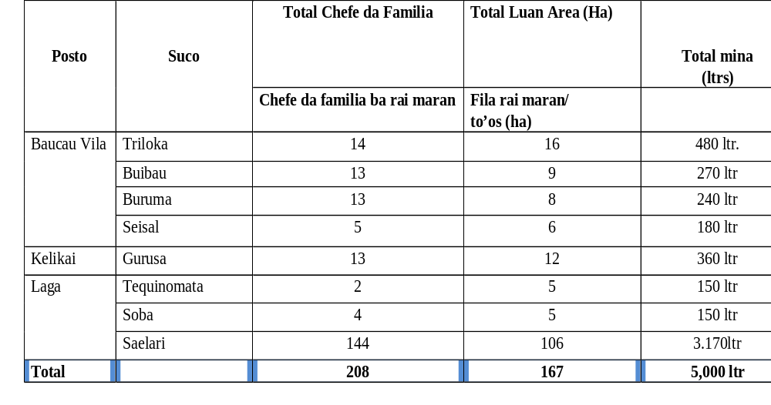
Fila Rai Gratuita ( Agrikultor nia To ‘os ) 2025

Slide 10
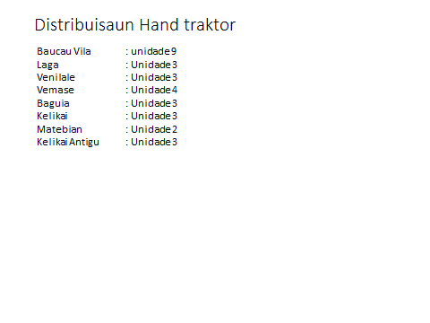
Fila Rai Bokon /Natar 2025
Postu | Natar Ha | Kombustivel | Benefisiariu | Obs
Baucau Vila | 2 27 ha | 6600 liter | 153 | Mina ba fila rai gratuita la kobre hotu balu uja hand traktor no balun uja karau no traktor kompanha inklui husi fatumaka
Vemase | 38 ha | 1020 liter | 54
Baguia | 34 ha | 1000 liter | 147
Total | 299 ha | 8620 liter | 354

Slide 11
EUIPAMENTUS NO FASELIDADES OPERASIONAIS IHA SM-A BAUCAU
DISKRISAUN | TOTAL | OBS
KARETA | 2 | Kondisaun Diak ( Cary 1 no Hilux 1)
 | 1 | Kondisaun Aat ( For Runger 1)
EKIPAMENTUS MEKANIZASAUN (TRAKTOR)
TRAKTOR BO'OT | TOTAL 33 | OBS
DIAK | 15 | 10 mak bele baku natar (5 nia elemen mak laiha)
A'AT KAMAN | 13 | Traktor hirak neé nia tinan operasaun liu 14 anus
A'AT Total | 5 | Traktor hirak neé nia tinan operasaun liu 14 anus
Centru Mekanizasaun | 1 | Kondisaun La seguru no durante neé lautuliza (15 anos abandona)
Makina Kua Hare | 5 | Sei Entrega ba Grupu Agrikultor Organizadu
Makina Kuda Hare | 12 | Sei Entrega ba Grupu Agrikultor Organizadu
Faselidades ba Pekuaria
Centru Saude Animal | 2 | Postu Laga no Venilale Falta Postu 6
Manga Vasina Kada Suku | 0 | 62 suku sedauk iha
Centru Produsaun Animal | 2 | Iha Fase identifikasaun ( Menus orsamentu atu estabelese)
Matadoro/fatin oho animal | 0 | Presiza atu garante naan kualidade no higiene
Tailo/fatin faan naan animal | 0 | Presiza atu prevene naan husi kontaminasaun
Floresta Plantas Industriais e Kafe
Centru Viverus Ai-Horis | 0 | Presiza atu prepara ai-oan Plantas industriaos no Ai-oan reflorestasaun
Presiza tau deit nia deskrisaun no nia numeru total

Slide 12
Distribuisaun Fini Batar no Hare
Distribuisaun Fini Batar Ba Postu Administrasaun
Baucau Vila | 2000 kg
Quelicai | 1700 kg
Laga | 1000 kg
Baguia | 1000 kg
Venilale | 1300 kg
Vemase | 1000 kg
Postu | Fini Hare/ Kg
Baucau Vila | 2500 Kg
Laga | 1000 Kg
BAguia | 1000 Kg
Quelicai | 1500 Kg
Vemase | 2000 Kg
Venilale | 2000 Kg

Slide 13
DADUS POPULASAUN ANIMAL MUNICIPIO BAUCAU TINAN 2025
 | POSTU ADMINISTRATIVO | Karau Timur | Karau Vaka | Kuda | Fahi | Bibi Timur | Bibi Malae | Manu Lokal | Manu Rade
 | Baguia | 521 | 655 | 311 | 1204 | 456 | 7 | 1691 | 1
 | Baucau | 652 | 136 | 803 | 3314 | 1885 | 720 | 4985 | 36
 | Laga | 2729 | 371 | 394 | 1377 | 1368 | 145 | 2475 | 14
 | Quelicai | 1044 | 115 | 304 | 837 | 454 | 120 | 991 | 5
 | Matebian | 1080 | 112 | 301 | 736 | 454 | 120 | 994 | 0
 | Kelikai Antigu | 1049 | 116 | 308 | 740 | 455 | 120 | 989 | 0
 | Vemase | 1516 | 55 | 343 | 958 | 497 | 242 | 1209 | 8
 | Venilale | 2841 | 964 | 1078 | 1614 | 1099 | 308 | 2698 | 10
 | Total | 11432 | 2524 | 3842 | 10780 | 6668 | 1782 | 16032 | 74
Aprezenta Apenas Total numero populasaun animais nian

Slide 14
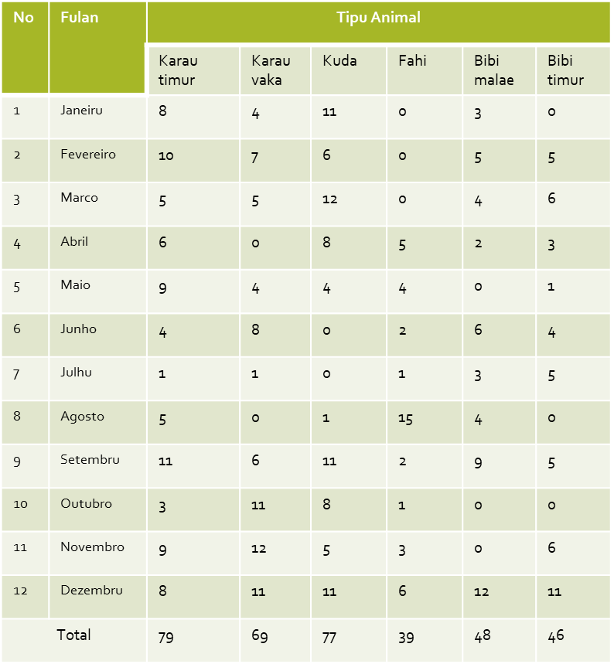
Dadus Matadoru
Dadus Tranzitu Animal ne’ebe Husi Baucau ba Municipio Seluk
Husi Munisipiu Baucau ba oho iha Munisipiu Seluk
No | Fulan | Tipu Animal ne’ebe Oho iha Merkadu Municipio Baucau
 |  | Karau timur | Karau vaka | Fahi
1 | Janeiru | 10 | 8 | 10
2 | Fevereiru | 12 | 10 | 8
3 | Marsu | 9 | 11 | 7
4 | Abril | 10 | 8 | 7
5 | Maiu | 10 | 12 | 8
6 | Junu | 9 | 11 | 6
7 | Jullu | 26 | 14 | 12
8 | Agostu | 22 | 18 | 10
9 | Setembru | 24 | 16 | 12
10 | Outubru | 10 | 12 | 6
11 | Novembru | 10 | 8 | 8
12 | Dezembru | 18 | 17 | 12
Total |  | 150 | 145 | 107
Total numeru Animal tinan ida nian ne’ebe oho iha Merkadu Munisipal Baucau la konta ho animal sira ne’ebe oho iha uma rasik

Slide 15
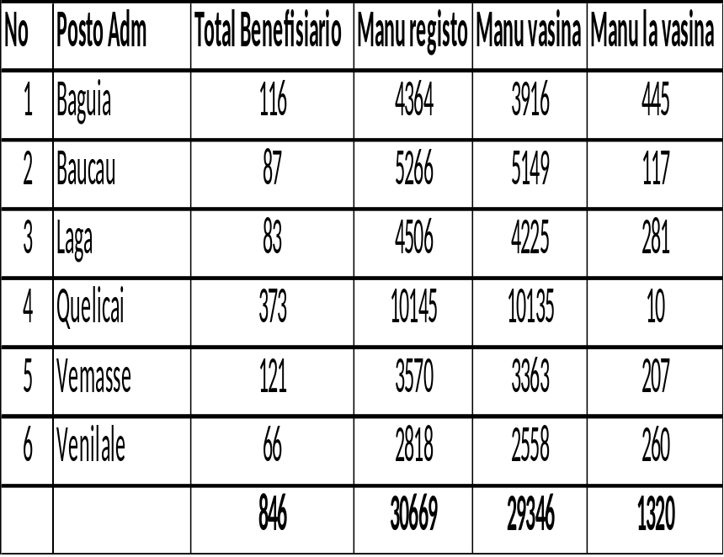
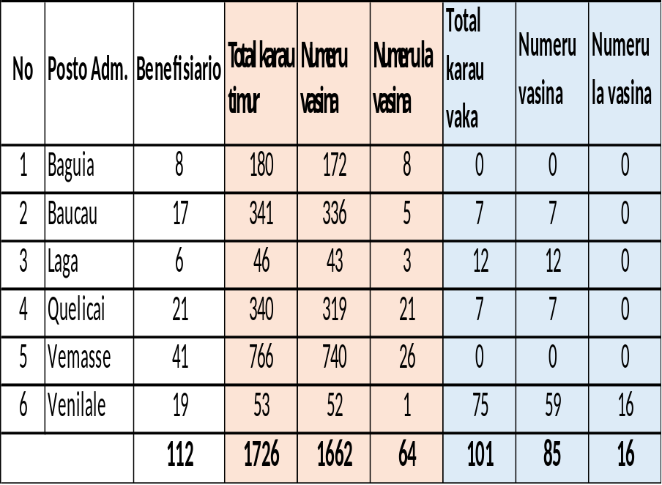
Dadus Vasinasaun Animal Tinan 2025
Vasinasaun ND ba Manu
Vasinasaun SE ba Karau Timur no Vaka
Apenas tau nia totalidade

